Slide 1
Forest Fires and Mathematics
APEC-Tsukuba Conference 2014
Emergence Preparedness Education
Moscow Center of Continuous Mathematical Education

Slide 2
Forest fires in Central Russia
The extreme heat of 2010 summer had caused the strongest fires in a number of regions of the Central and Volga Fede-ral districts.
The fires raged in 22 subjects of the Russia.
Happened about 30 000 of forest and peat fires on a total area of nearly 1 mln ha.
The map of the fires and smokes over Central Russia, 2010 (photo by NASA)

Slide 3
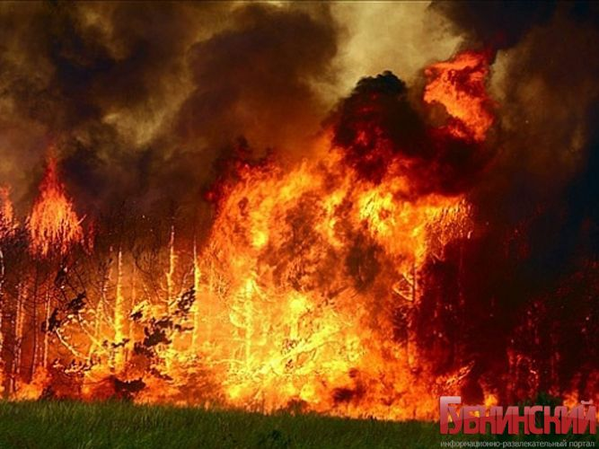
Forest fires in Central Russia
Burned about 2 5000 of living buildings.
The fire got to nuclear centers located in Sarov (Nizhniy Novgorod region) and Snezhinsk (Chelyabinsk region).
In connection with the fire situation in 7 regions – N.Novgorod, Voronezh, Vladimir, Moscow and Ryazan regions, Mari El and Mordovia the emergency regime has been introduced.

Slide 4
Forest fires in Central Russia
In the 1990s the Russian state and government couldn't support forestry and fire-prevention measures on boundless spaces of Russian forests. As the result:
Overgrowing of fire-breaks
Reducing the forestries and foresters in number and funding
The fire aviation had declined
All these factors have led to increased losses from forest fires that had been uncontrolledly spreading over vast territories, closely approaching the towns and villages.

Slide 5
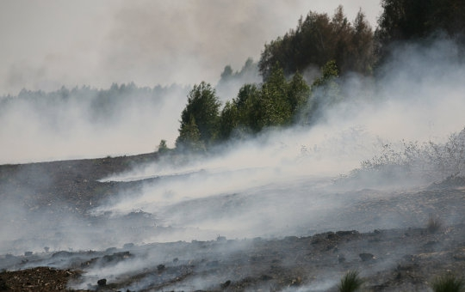
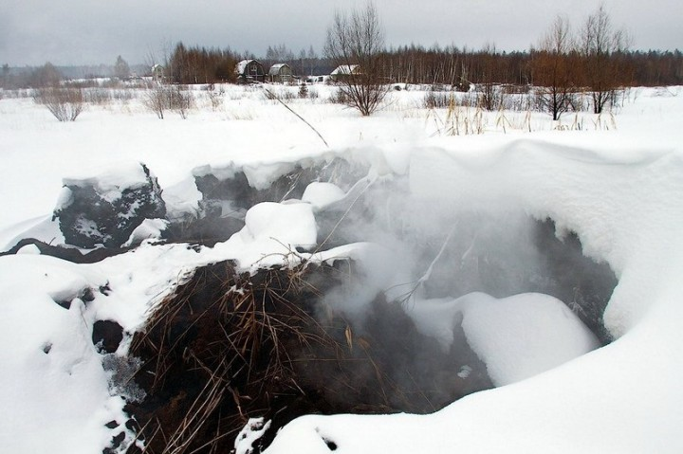
Burning peatbogs
The main danger for the major cities is the toxic smoke from burning peat in the suburb area.
Peat is able for combustion if the humidity is less than 40 %.
The depth of burning might be limited to the level of groundwater. Peat fire can last months and years.
Peat burns in summer and in winter it burns too

Slide 6
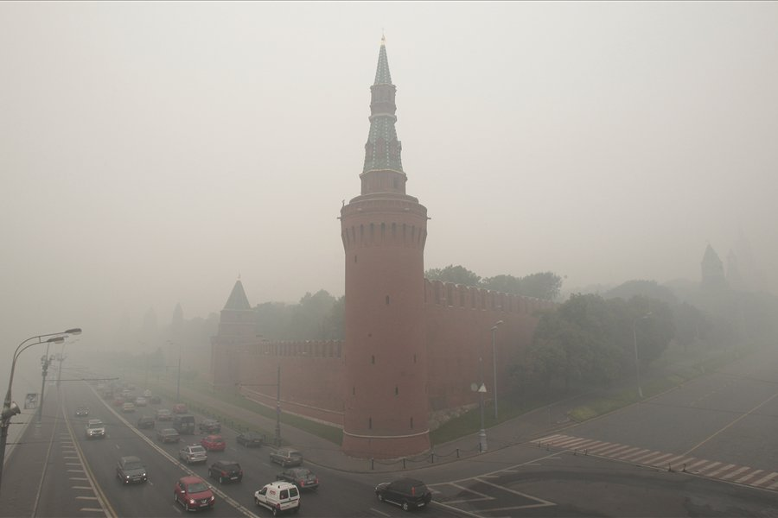
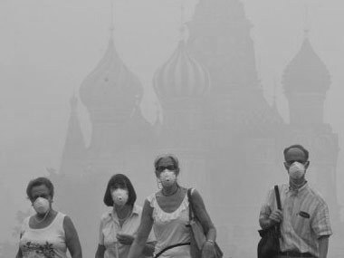
Moscow Smoky August (2010)
In July and August 2010 smoke from peatlands covered Moscow.
Fragments of the chronicle (http://ru.wikipedia.org).
Aug 6. Halted the work of the German Embassy in Moscow
Aug 7. Disrupted the work of Moscow airports.
Aug 8. Stopped shipping in the Moscow river
Aug9 . The Head of the Moscow Health Department had stated that due to the smoke the mortality in Moscow has doubled.
Aug 2010. The Kremlin
Walking in Moscow

Slide 7
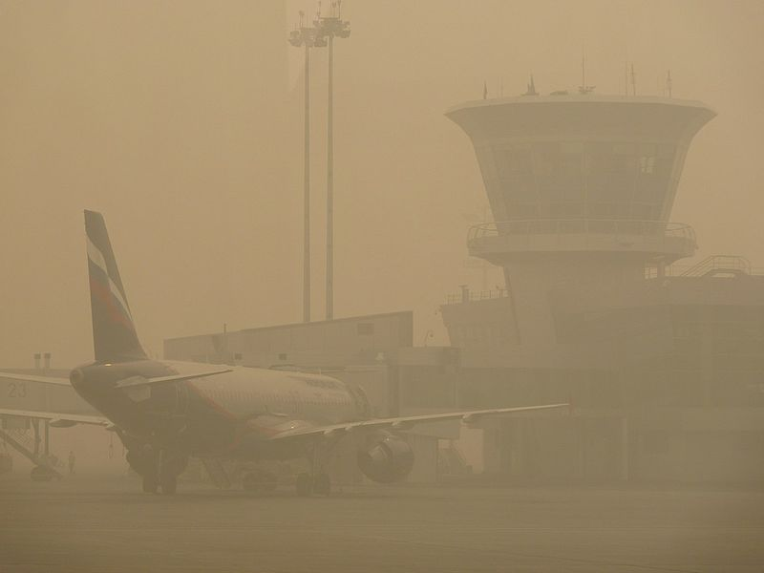
Moscow Smoky August (2010)
The root cause of natural peat fires, and because of which formed smoke, was active drainage of wetlands and extracting peat in 20-60 years of the XX century under the project of electrification (GOELRO).
In the late 60-ies due to the active development oil and gas industry need in peat decreased. Drained peatbogs began to be closed, but were not filled with water.
Arpt. Sheremet’evo. Aug 2010. By S.Gutnikov

Slide 8
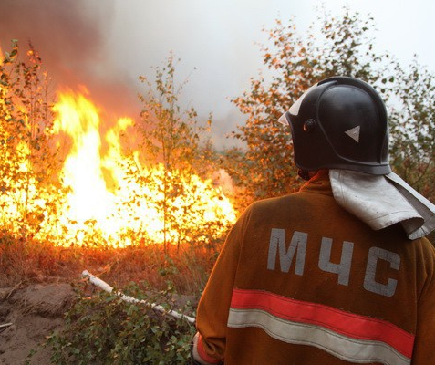
What has school math to do with it? Four aspects
Forecasting
Modeling
Behavior
Liquidation of
consequences

Slide 9
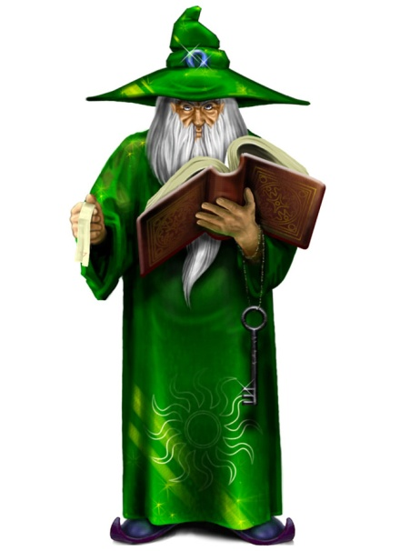
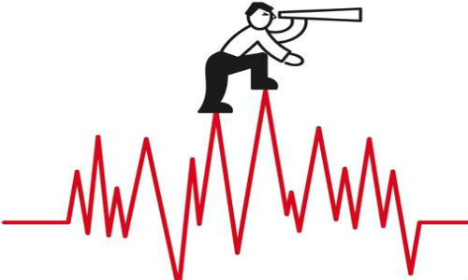
Forecasting and forecasts
Predictions are very interesting but are outside the scope of science.
Forecasting natural disasters is a daunting challenge, which does not yet have a satisfactory solution.
We offer not to create a false ideas of what our students can learn about forecasting natural disasters within lessons of mathematics.
It concerns not only students but teachers first of all.

Slide 10
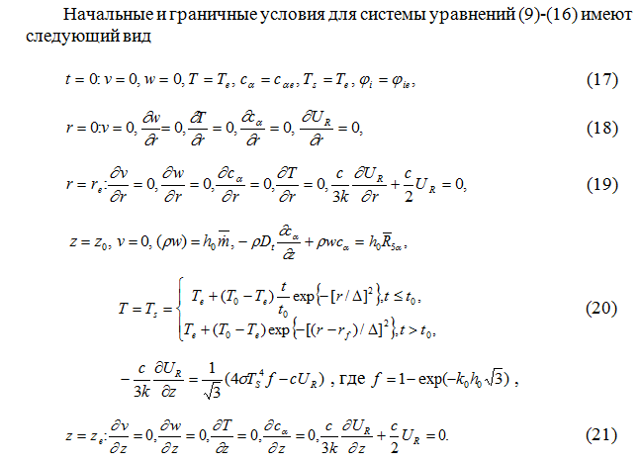
Modeling

Slide 11
Modeling
Any serious and credible modeling of complex natural phenomena (such as forest fires or floods) can not be reached by means of school mathematics or physics.
Conclusion: Here we are bound to attract attention of the Governments and Public to the fact that mathematics today makes technology of the future.
If we want to understand better nature in 20-30 years, now we have to support math education as the base for long-term development.

Slide 12
Behavior
The value of disaster preparedness education can hardly be overestimated.
There is only one doubt – is this really topic for lessons of mathematics?
Much more important are the lessons of life safety, in which students are taught to understand the nature of disasters specific to the region and to act correctly when this disaster happened.

Slide 13
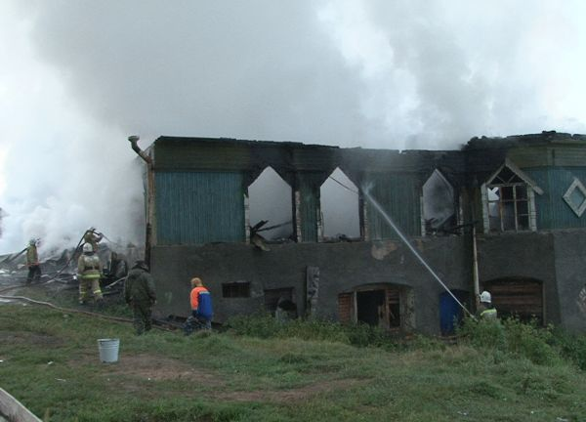
Liquidation of consequences
Liquidation of a disaster consequences is mainly a question of funding.
The question of insurance of property and home arises for discussion and regrets in our country every time immediately after large-scale natural disasters.

Slide 14
Insurance
In 2010 this was caused with wildfires. Most of the payments received from the federal budget .
In 2013 the reason was a flood in the Far East, when it became clear that the main burden of compensation again falls on the budget because only 10 percent of the population had insured their own apartments and houses .
State compensation never covers all losses (can’t).
Centralized mechanism of financial compensation works slowly and formally, becomes a subject to fraudulent schemes, plain theft and corruption.

Slide 15
Lack of insurance literacy
In countries with developed market economies, it is generally accepted that the insurance industry is a strategic sector of the economy. However, in Russia the insurance business has not become a part of the public culture so far. Most people have lack an understanding of the spirit and purpose of the insurance. Therefore, citizens and public servants and even employees of insurance companies need to learn more about insurance principles.

Slide 16
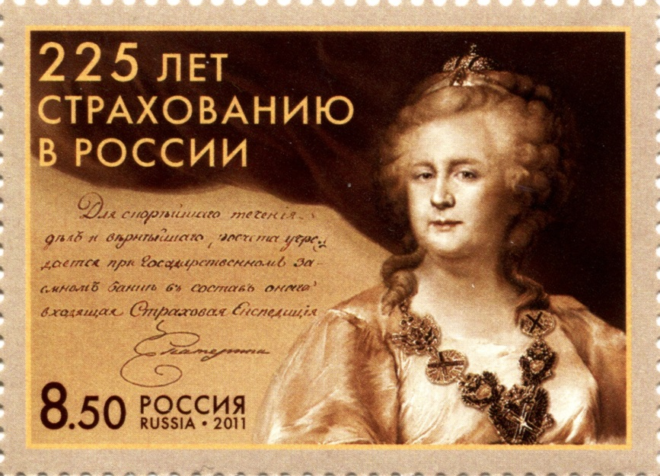
This is our business
Therefore, the increase in literacy in matters of insurance is a priority if we are talking about the elimination of consequences of natural disasters.
Here math lessons in school can help greatly
The post mark “225 years since the first insurance company has been established n Russia”
Post of Russia, 2011

Slide 17
The Conception of math education development
On December 24 of 2013 Russian Government had accepted The Conception of Mathematical Education Development in accordance with the charge of Russian President given in May of 2012.
It is rather short document that sets the main goals and principles of math education in schools and universities.
Firstly in latest history the Russian Government states unsatisfactory status of common and compulsory math education and announces the necessity to implement the education on different levels depending on individual educational interests and demands of a student.

Slide 18
Three levels
The First Level – for life
The Second Level – for professional activity
The Third Level – for mathematical creativity and fundamental science development
Regarding the First Level the Conception underlines that every student must reach mathematical literacy enough for everyday life.
This include elementary statistical and probabilistic literacy which are expected as a part of common public culture.

Slide 19
Statistics and probability in Russian schools
Since 2004 statistics and elements of probabilities theory are included in Federal Educational Standards.
Now we have got the first successful experience in teaching statistics and preparing teachers for this.
Banking, management, insurance and other public phenomena bear probabilistic character and we pay much attention on these subjects in our curriculum when planning the course of statistics and probability for middle and high school.

Slide 20
Regular textbooks
In 2004 our group leaded by Prof. Y.Tjurin had issued the first regular textbook for 7-9 grades on Probabilities and Statistics for Moscow. Now it is in use not only in Moscow.
In 2014 we finished and issued the textbook for 10-11 as a sequel of the first one

Slide 21
Insurance literacy is a part of probability for 7-11 grades
As the way from school mathematics to everyday events lies through learning statistics, we can apply various subjects to design the lessons and poses the problems. So we do when talking about life safety and natural disasters in teaching and studying statistics.
The first example has been dragged out from the lesson in grade 7

Slide 22
The lesson for 7 – 8 grade. Comparison and hypotheses
The main task is to involve students into discussion about some features of two kindred charts.
The teacher tries to wake the ability for comparison and putting hypotheses.
Being out of possibility to check set hypotheses we shouldn’t encourage students to think they and prove but we want them to fantasize and seek and put convincing arguments and reasons.

Slide 23
Two charts
The left one shows number of payments, the right shows the total paid within two risks (buildings and property lost in fires including wildfires)

Slide 24
Two charts
4. What can you propose to explain why in 2007 the number of payments was much less then in other years? Your hypotheses, please…
5. How should you explain why in 2006 the number of payments is less while the total amount is greater than in other years? Hypotheses, please…
6. How might it be that total insurance compensation for lost property is growing year by year when the number of payments is oscillating?
7. What could you assume about quantity of insurants and the tendency?
3. What significantly influences the total amount of payments?
1. What specialties you can notice in the charts?
2. What significantly influences the number of payments?
8. Can you make any assumption about the strategy of the insurance companies?

Slide 25
The conclusion
The lesson had been designed to encourage students to hypothesize and make assumptions from graphically presented information. It’s no important that we have no enough data to check the hypotheses. The best tool of a statistician is his culture, intuition and fantasy with which he processes the statistical data.
The second aim is increasing understanding about insurance as a way to defend homes and property when a disaster occurs. So the teacher must focus on the tendency of growing the number of insurants and insured sum through the years.

Slide 26
9 – 11 grades. Math Expectation of a Discreet Random Value
One of the main our ideas is to lead students to the understanding effect of Large Numbers Law. So the concept of ME grows to one of the central concepts. We try to explain to teachers that the very core of ME is very simple – ME plays the role of “theoretical average”. We success slowly.
The lesson below is designed as a mathematical play with the subject concerning the insurance business as the business of very probabilistic nature.

Slide 27
How to manage an insurance company?
We want to establish an insurance company in a rural area of Central Russia. Our specialization might be the insurance of living buildings and property against wildfires.
Now we offer only one kind of insures risk:
“Loss or damage of wood buildings and property in a fire”

Slide 28
What is the insurance premium?
Determine for ourselves that an insurance company is not a charitable corporation. It exists and works due to insurance premiums paid by insurants. The company mustn’t work for losses.
Now we will consider only mathematical aspect of forming premiums.

Slide 29
What makes the insurance premium?
Now please put assumptions – what the premium depends on? Which items are more sufficient, which – less?
The total sum of assumed insurance compensation
2. The probability of the insurance accident
3. Common weal
Number of insurants
5. Competition on insurance market
6. Governmental regulation of insurance activity
7. The necessity income of the company (including necessary for salary, rent, taxes, covering accidents etc.)

Slide 30
Main factors
The teacher must lead students to the main ideas that most sufficient factors are:
The total sum of assumed insurance compensation
The probability of the insurance accident
3. The necessity income of the company (including necessary for salary, rent, taxes, covering accidents etc.)
We can discuss all of them but all rest are additional factors we have to take into account. Lets return to them later

Slide 31
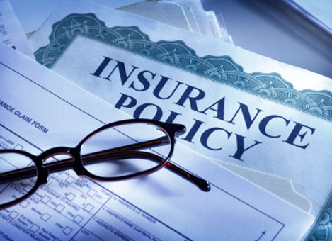
Assumptions and followings
Lets accept that for successful operating our company must get the average 200 rub from one insurance policy (one insurant).
Let X is the insurance compensa-tion in an accident for one policy.
The premium equals A rub.
To get not less than 200 rub in average we need provide the inequality
Where EX is the math expectation of the compensation to be paid in an accident.

Slide 32
Values and probabilities
So we must learn about values of X and their probabilities.
After studying many factors in the region (which are the main?) we define our base compensations:
Accident | Full destruction | Partial loss | Minimal damage
Average. compens. | 1 500 000 rub | 500 000 rub | 50 000 rub

Slide 33
Values and probabilities
What do we need more? Probabilities.
What do you think of which risk is greater – of the full destruction or partial loss or an insufficient damage?
What do we have to do to know about them? Collect the data of observation for some years to find the frequency for every of accident type as an estimators for the probabilities.
Let’s assume that after the serious research we learnt three probabilities
Accident | Total destruction | Partial loss | Minimal damage
Prob. estimation. | 0,0003 | 0,0014 | 0,0132

Slide 34
The comment
We have posed much simplified problem. What didn’t we take into account?
The compensations might be more various.
Insurants are in various conditions and the fire is not equally probable for all of them.
Can we take into account absolutely all circumstances for all insurants?
Insurance gives the averaging probable risks
and compensations

Slide 35
The fourth probability
Accident | Total destruction | Partial loss | Minimal damage
Prob. estimation. | 0,0003 | 0,0014 | 0,0132
When making the table which case did we forget?
We see that the probability of luck issue is greatest and close to 1. This is a main principle of insurance.

Slide 36
The distribution and ME
Now we’ve got the distribution of X:
Find the expectation:
So

Slide 37
Why does it work?
If we assume the policy price (premium) to be exactly 2000 rub and all our assumption are true then we’ll get the minimal necessary income.
This is provided by Large Numbers Law, which says that
the true average compensation must be close
to the found math expectation
if we sell enough of policies (have enough of customers).

Slide 38
The questions
What if we highly increase the price for the policy?
What might happen if we sell not very many of policies?
What would change if the number of insurants grows and we sell much more policies than now?
What would happen if we got wrong in estimating probabilities?
What if a huge fire occurs and the quantity of injured people grows much more than we could forecast?
What can we do to make our model more complicated and flexible?

Slide 39
The homework
Suggest to make the model and solve the problem about the minimal premium with another assumptions. Moreover – give the questions set above to think about. On the next lesson the posed questions must be discussed.
Firstly one can decide it is not math. The one is wrong. Such “non-mathematical” discussions develop students abilities for creative and critical thinking, making conclusions and hypotheses better than solving problems in traditional school math.

Slide 40
More
The presented lessons make only small part of possible examples how to connect nature and school math using probability.
Try to design a lesson dedicated to probabilistic estimation of reserves (water, food, medicines) needed for shelters in a city. We can proceed from given population, known probability that a dweller comes to the shelter, from known average duration of stay.
What would change if we make two small shelters in different districts of the city instead of one large? Assure you – this is good and not simple problems to discuss and solve mathematically. How to do it in most interesting way?

Slide 41
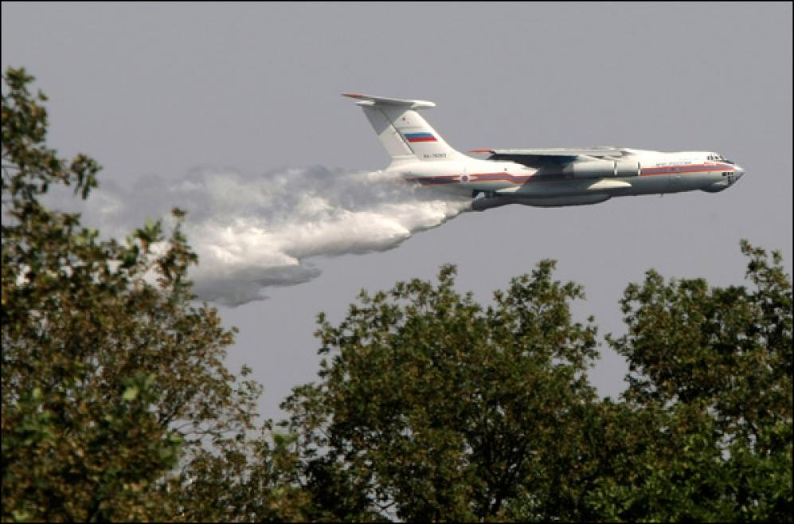
Thanks for your attention

